Slide 1
Computer Organisation 1
The Instruction Set Architecture cont’d

Slide 2
Instruction Set Architecture
The instruction set for a computer is the set of instructions which the processor can execute - the instruction set can be said to define the processor.
Each processor has a different instruction set.
Instruction sets differ in the following respects:
1. Size of instruction
2. Type of operations (opcodes, functions)
3. type of operands operated on
4. type of results from operations

Slide 3
Instruction Set Architecture
We can compare high-level languages such as C++, Java, Pascal, Modula, Cobol, and see very little or no difference between, say, the C++ program written for one processor compared with the C++ program for another processor.
However, the compiled (translated) machine language program will be completely different for different processors.

Slide 4
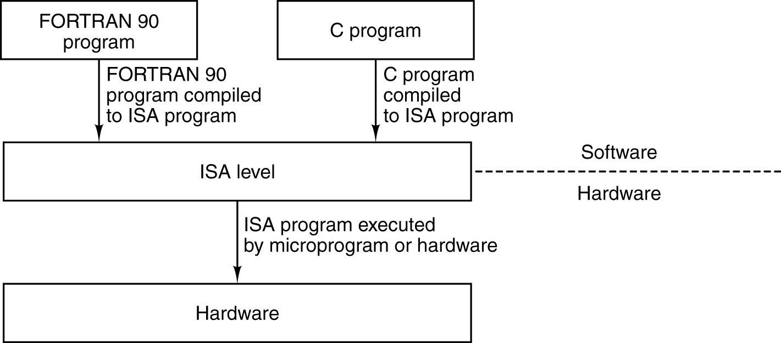
ISA Level
The ISA level is the interface between the compilers and the hardware.

Slide 5
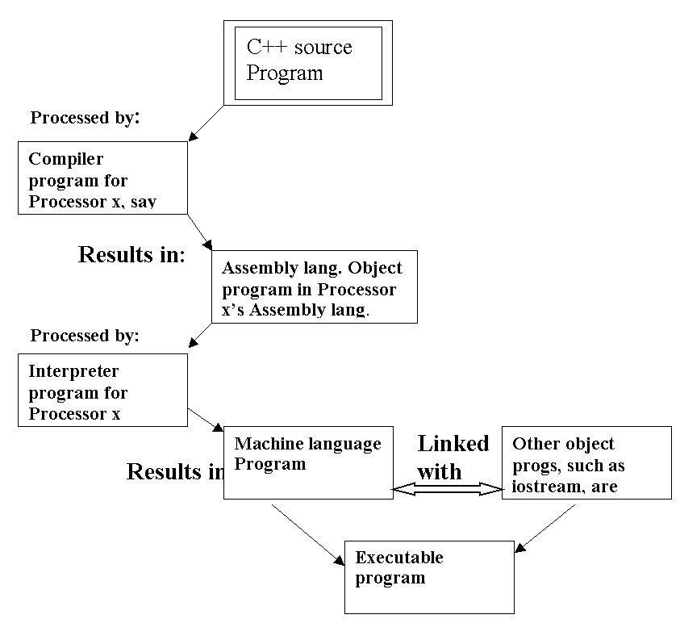

Slide 6
Instruction Set Architecture
The process of getting results from a computer program, may be as follows:
A source program is translated by a compiler (compile time) into an assembly language object program.
The object program (assembly time) is then translated into a machine code object program.
This program is now linked with other object code (link time) such as iostream, mathlib, etc.
The resulting executable program can be run or executed (run time) and results obtained.

Slide 7
Compiler v Interpreter
A compiled program is converted completely into machine code and then made into an executable program by linking with library programs, such as IO programs
An interpreted program is held in memory as a source program, and each line is translated each time it is encountered

Slide 8
Program in BASIC language
60 REM Simple BASIC Program - Count To Ten
70 PRINT "Hello! I am a sample BASIC program“
80 PRINT "that counts to ten.“
90 PRINT //print a blank line
100 FOR I=1 TO 10
110 PRINT I
120 NEXT I
130 PRINT
140 PRINT "Thanks for running me."
150 END
Line 110 is translated 10 times – each time it is encountered

Slide 9
Compiler v Interpreter
Compiled programs in C++, COBOL or Fortran are compiled into the machine language of the of the target computer architecture; the object (machine language) programs are not portable across architectures, unless the source program is recompiled.
Compiled programs run up to 200x faster than interpreted programs (in languages such as Perl, Applescript, which are largely platform independent)
JAVA programs are compiled into an intermediate form called bytecodes, which execute 10x slower than compiled programs; however, JAVA’s bytcode platform independence is a major plus

Slide 10
Instruction Set Architecture
The incompatibility of machine languages is circumvented by Java technology
Programs are compiled into Java ‘bytecodes’ – a machine language for a virtual machine.
If the processor is running the so-called Java Virtual Machine (JVM), written in the assembly language of the target machine, then the JVM interprets each Java bytecode and executes it as though it were running on Java hardware.

Slide 11
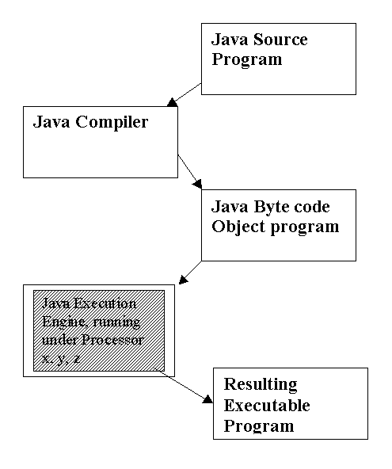

Slide 12
Instruction Set Architecture
Web Browsers such as Netscape, Internet Explorer, Mosaic are all Java-enabled. The user clicks on a link, and activates a Java program called an applet (little application) which comes across the network and runs on the user’s computer. Being Java-enabled allows for calculations and interaction with the host site.

Slide 13
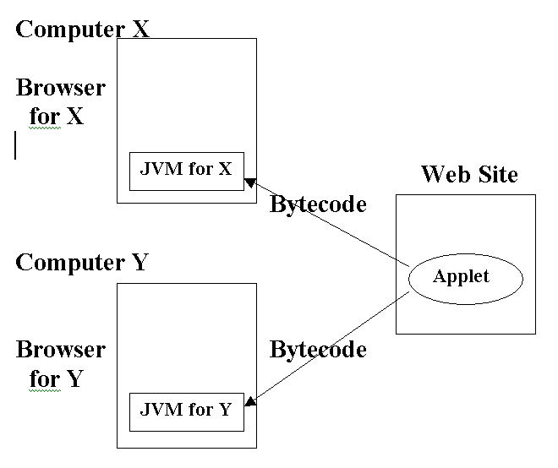

Slide 14
JAVA Virtual Machine
Example from Murdocca and Heuring

Slide 15
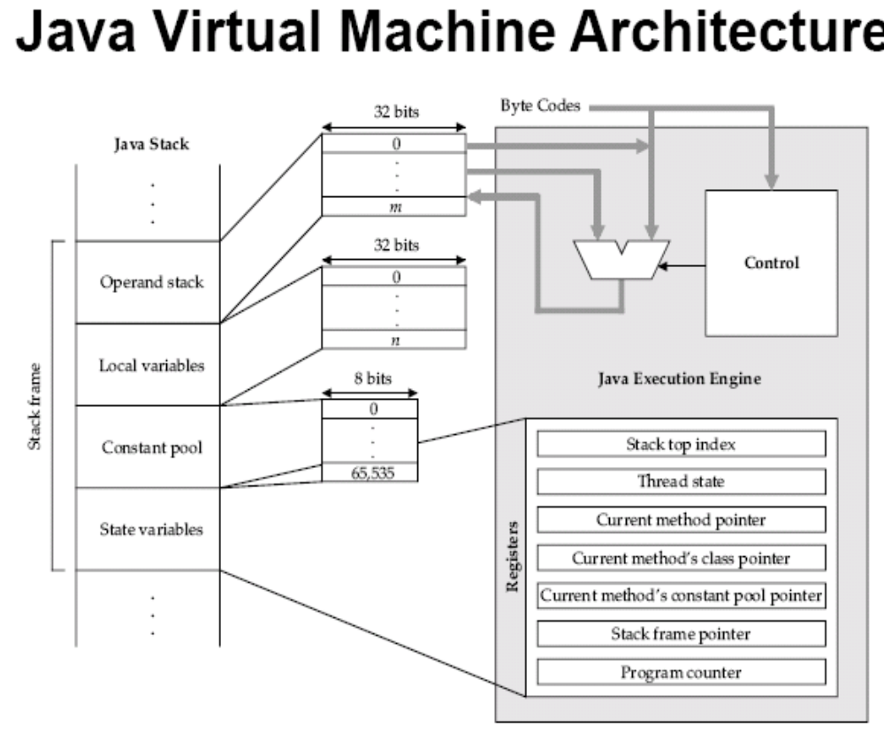

Slide 16
CISC and RISC
A further distinction between processors – and therefore instruction sets - is to do with the principle of the number of instructions in the instruction set.
We can classify processors wrt whether they are CISC or RISC.
That is, Complex Instruction Set Computer
or Reduced Instruction Set Computer

Slide 17
CISC and RISC
The RISC machine has fewer instructions and a restricted access to the Memory – allows only Load and Store operations – and does nearly everything via Register operations.
The CISC machine allows a wide range of memory operations. For example, the Dec VAX 780 had 15 MULtiply opcodes which could operate on both memory and register operands:
MULB2 MULB3 MULD2 MULD3
MULF MULG MULH MULL MULP MULW
And about 36 different MOVes.

Slide 18
CISC and RISC: Evaluate the Java code: x = x + (z*y);
In RISC parlance:
Load x, R1 // load (x) into Register 1
Load z , R2
Load y, R3
Mpy R2, R3 // result in R3
Add R1, R3
Store R3, x
In CISC-type assembly:
Mpy3 z, y, T1 // 3 var instrn, T1 memory
Add2 T1, x // result in x

Slide 19
The ARC Computer
We will spend some time looking at the so-called ARC (‘A RISC Computer’) assembly language from Murdocca and Heuring.
This imaginary language is based on the SPARC architecture developed by Sun Microsystems in the late 80s.
ARC memory is a 32-bit machine with byte addressable memory.
All instructions in ARC are 32 bits (one word) long.

Slide 20
The ARC Computer
ARC has thirty-two 32-bit registers, and a PC and IR.
There is also a PSW – process status word. Aka Process Status Register PSR. Within the PSW are the Condition Codes (Arithmetic Flags n,z,c,v) – 4 bits which specify how the last instruction ended.
The Condition Codes are as follows:
z-bit ‘Did last instruction result in zero?’
n-bit ‘Last result less than zero ie negative?’
c-bit ‘Carry out from last instruction?’
v-bit ‘Overflow from last instruction?’

Slide 21
The ARC
32 32-bit registers
Program counter %pc
PSR %psr with condition codes ccs Z, N, C, and V
Register 0 (%r0) has always value 0
R14 is the stack pointer (%sp)
%r15 is the subroutine link register
all instructions are one word long
No memory operations except load ld and store st

Slide 22
ARC Instruction format:
Label Mnemonic source oprnds dest oprnd !comment
Example:
L1: addcc %r1, %r4, %r4 !add r1 to r4
Instructions translate from this mnemonic form to 32-bit machine language instructions

Slide 23
Pseudo ops (Directives)
.begin and .end tell the assembler when to start and stop assembling.
.dwb means ‘define a word block’ – for declaring arrays
.org x causes the next instruction to be assembled in memory location x.
Eg .org 2048
That is, place first assembled program instruction in location 2048

Slide 24
The ARC Computer
Label: Opcode src operand(s), dest operands !comment
Example code:
ld [x], %r4 ! load (x) into register 4
L1: addcc %r4, 5, %r6 ! Add 5, put result in r6
bneg L1 ! if (r6) < 0 keep adding
st %r6, [z] ! store positive result in z

Slide 25
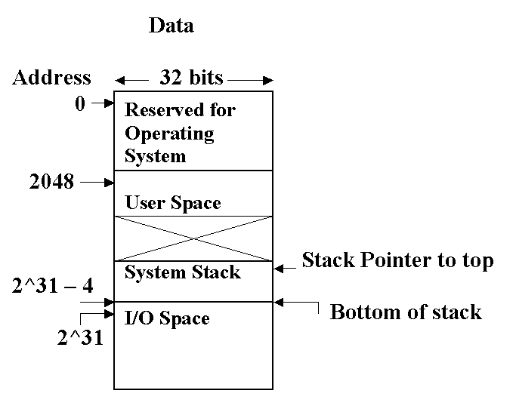
Memory in the ARC

Slide 26
ARC Memory
The user space in the ARC computer starts at location (byte) 2048. That is, 0 to 2047 are reserved for the Operating System. So the user’s program can grow from 2048 until it meets the system stack starting at location 2^31 – 4.
The system stack and the user space ‘compete’ for the free space between them – the user program can ‘grow’ downwards and the stack ‘grow’ upwards. This accommodates both large programs with small stacks and small programs which need large stacks.

Slide 27
Big-endian v Little-endian
The ARC has a 32 bit integer format, referred to in the big-endian format.
That is, in a 32-bit word, at memory address byte x, say, containing the ASCII string ‘ABCD’:
‘A’ is stored in byte x, ‘C’ in byte x+2, ‘D’ in byte x+3

Slide 28
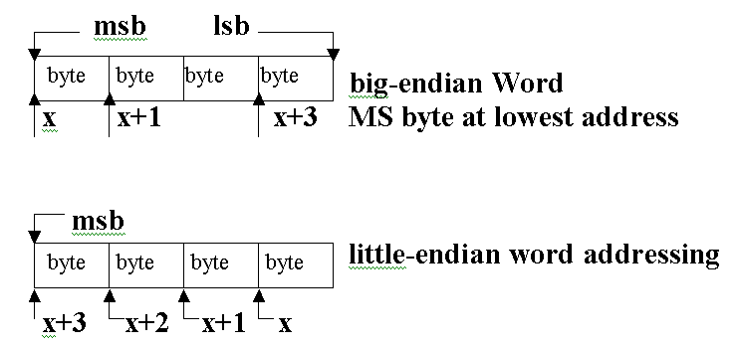

Slide 29
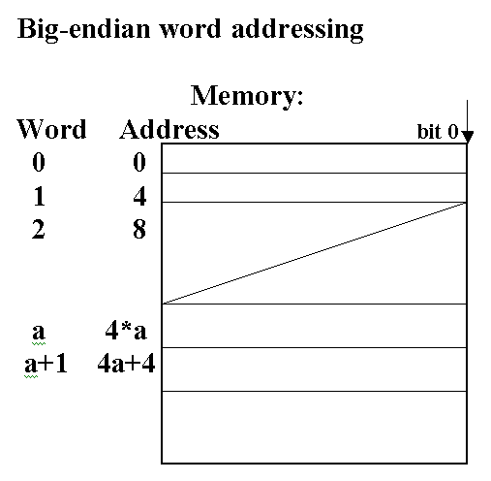
Big-endian addressing

Slide 30
Big-endian
String ‘DAVIS’ stored as:
Word 1: D A V I
Word 2: S _ _ _

Slide 31
Summary
Instruction set defines the processor
Whereas high level languages look the same for each machine, each instruction set is different for each processor.
High level source programs are translated (compiled or interpreted) into assembly object programs (Java bytecode); object program may be linked with other library code (classes) to form an executable program.
Instruction sets may be categorised as RISC or CISC

